Slide 1
INTRODUCTION
Parenting is not an easy job, some say it is the toughest job there is.
It is likely for parents to guide their child as they grow to keep them away from danger.
Parents should also give their children enough independence but how can they be ensured of their child’s safety?
“Technology is best when it brings people together”

Slide 2

CONCEPT / EXPLAINER VIDEO

Slide 3
VIRTUAL NANNY: A CHILD MONITORING APPLICATION FOR GUARDIANS
Michael John Deligero
(Project Manager)
Ana Marie Gonzales
(UI Designer)
Mary Welcey Guillen
(Software Engineer)
Christine Joy Leonardo
(Technical Writer)
Shara Marie Reyes
(Database Designer)

Slide 4

CHAPTER I
VIRTUAL NANNY: A CHILD MONITORING APPLICATION FOR GUARDIANS
OBJECTIVES OF THE STUDY
SCOPE AND LIMITATIONS OF THE STUDY
SIGNIFICANCE OF THE STUDY
CHAPTER III

Slide 5
OBJECTIVES OF THE STUDY
This study aims to develop a real-time child-monitoring application for guardians to monitor child’s activity throughout the day.
In order to achieve this aim, the following specific objectives are:
1. to gather information on the problems and concerns of parents and guardians in child-monitoring;
2. to determine features that help parents in knowing the activities of the child;
3. to identify mechanism in monitoring the child; and
4. to design an algorithm to help guardians monitor the child.
CHAPTER I

Slide 6
SCOPE AND LIMITATIONS OF THE STUDY
The application covers the actual map of Cebu Province using the Google Maps.
It can connect up to 3 child accounts every guardian account.
Each account can be logged on by only one device at a time to prevent conflict in location tracking.
Virtual Nanny is a mobile application that run on android phones with Android API Level 16 or Jelly Bean as the minimum SDK up to the latest.
When a child is in danger or needs immediate attention and sends SOS, guardians may receive the location of their child and quick messages through SMS, but cannot implement the other features.
Therefore, the application requires internet connection to finely perform all its features.
CHAPTER I

Slide 7
SCOPE AND LIMITATIONS OF THE STUDY
It is essential that the guardian and child owns and is capable to operate an android smartphone.
The mobile application uses the GPS (Global Positioning System) technology through mobile devices thus, the child needs to have a GPS enabled smartphone to track their exact location and must at all times bring their mobile device with them.
In the same manner, the child’s smartphone should also have a built-in pedometer to implement the pedometer feature.
Not all schools in Cebu allows phones in the campus, in this case, they cannot be monitored on their school grounds.
When the mobile device of the child is switched off, battery is empty or internet connection is poorly or not available, the parent is notified but the application fails to provide the exact location. Nevertheless, the application stores the last trackable location of the child. Though the location history feature stores up to the past three days only.
For data gathering, the proponents will conduct a survey among the parents of Tugbongan National High School to gain wider understanding on parental apprehensions and concerns in childrearing activities.
CHAPTER I

Slide 8
SIGNIFICANCE OF THE STUDY
Children
Parents and Guardians
Babysitters and Child minders
Researchers
Future Researchers
CHAPTER I

Slide 9
CHAPTER II
VIRTUAL NANNY: A CHILD MONITORING APPLICATION FOR GUARDIANS
RELATED LITERATURE
COMPARATIVE MATRIX
CHAPTER III

Slide 10
RELATED LITERATURE
In this modern and fast moving world, human safety and security has become an important issue.
The Global Positioning System or GPS is a satellite-based system that can be used to locate positions anywhere on the earth.
Geofencing allows virtual boundaries to be defined on a map.
Benefits of monitoring applications.
CHAPTER II

Slide 11
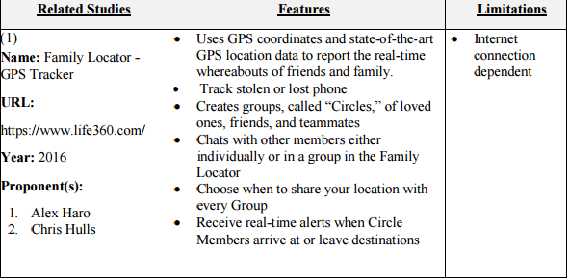
COMPARATIVE MATRIX
CHAPTER II

Slide 12
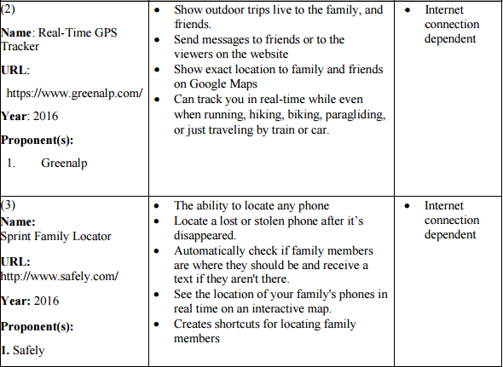
COMPARATIVE MATRIX
CHAPTER II

Slide 13
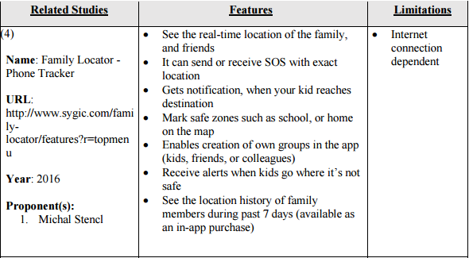
COMPARATIVE MATRIX
CHAPTER II

Slide 14
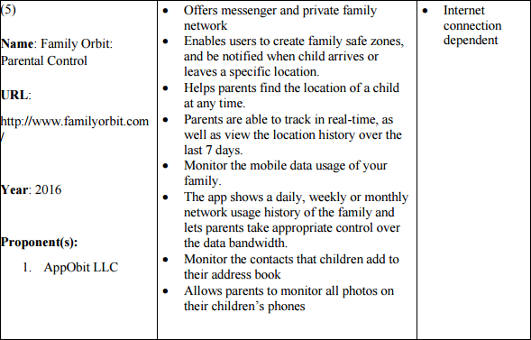
COMPARATIVE MATRIX
CHAPTER II

Slide 15
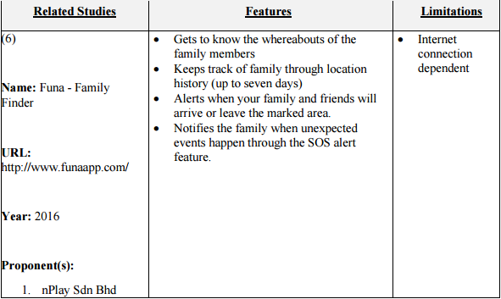
COMPARATIVE MATRIX
CHAPTER II

Slide 16
CHAPTER III
VIRTUAL NANNY: A CHILD MONITORING APPLICATION FOR GUARDIANS
SOFTWARE ENGINEERING METHODOLOGY
PLANNING/CONCEPTION/INITIATION PHASE
ANALYSIS-DESIGN PHASE
DEVELOPMENT/CONSTRUCTION/BUILD PHASE
CHAPTER III

Slide 17
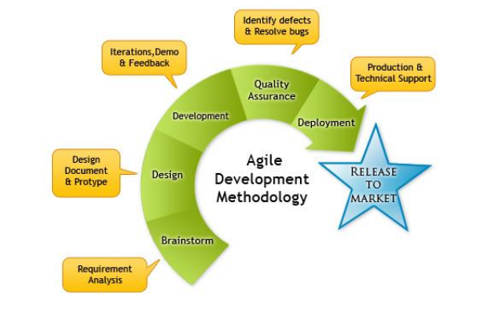
SOFTWARE ENGINEERING METHODOLOGY
CHAPTER III

Slide 18
PLANNING/CONCEPTION- INITIATION PHASE
CHAPTER III
VIRTUAL NANNY: A CHILD MONITORING APPLICATION FOR GUARDIANS
CHAPTER III

Slide 19
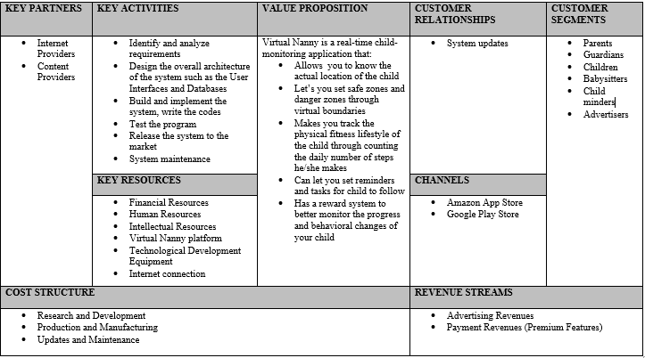
BUSINESS MODEL CANVASS
CHAPTER III

Slide 20
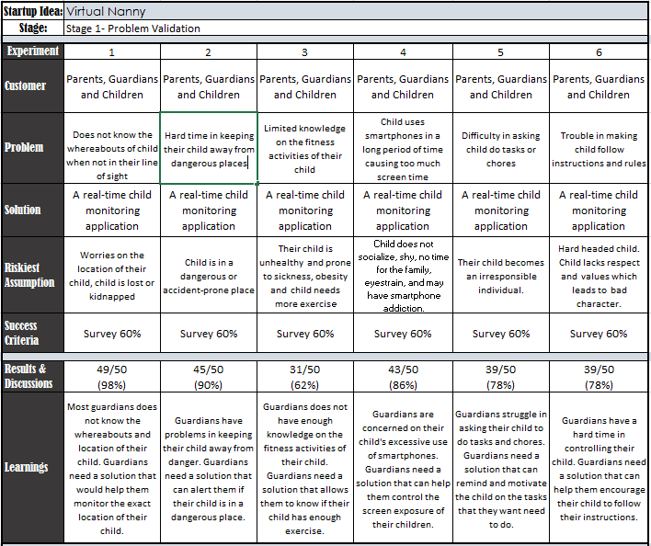
VALIDATION BOARD
CHAPTER III

Slide 21
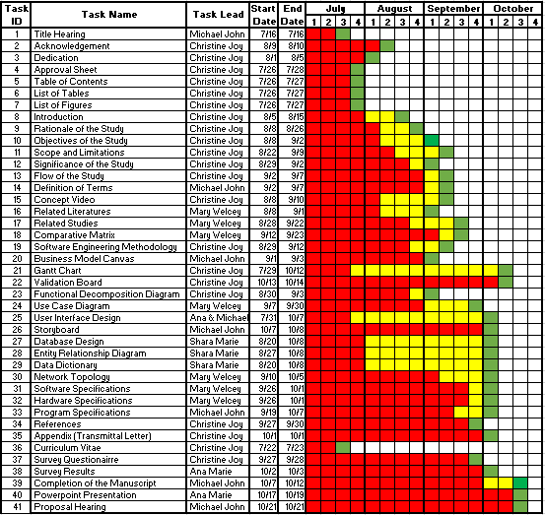
GANTT CHART
CHAPTER III

Slide 22
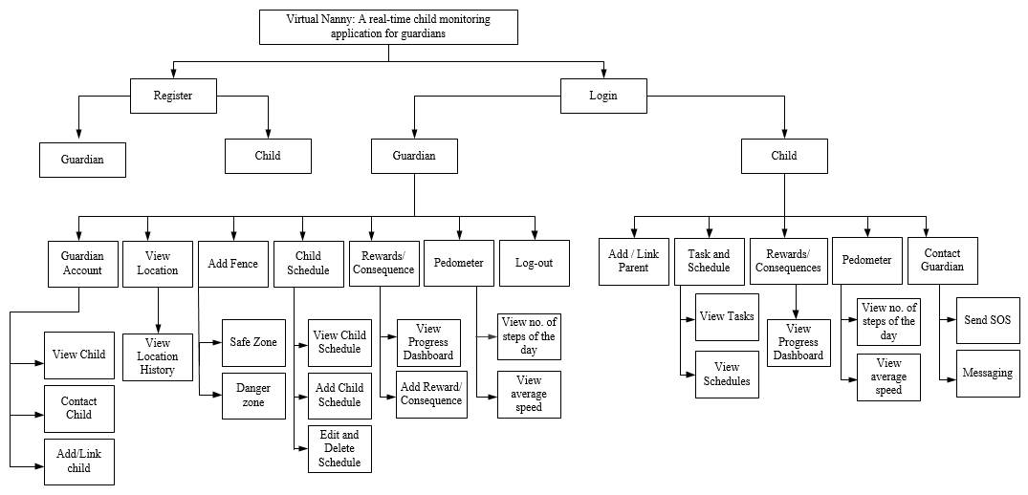
FUNCTIONAL DECOMPOSITION DIAGRAM
CHAPTER III

Slide 23
ANALYSIS- DESIGN PHASE
CHAPTER III
VIRTUAL NANNY: A CHILD MONITORING APPLICATION FOR GUARDIANS
CHAPTER III

Slide 24
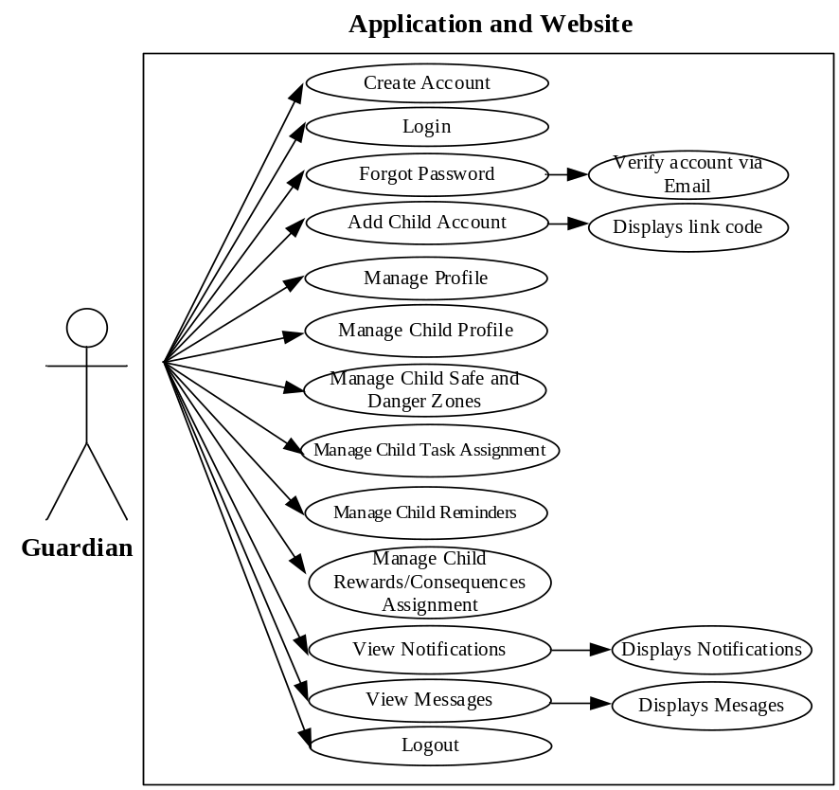
USE CASE DIAGRAMS
Guardian Use Case Diagram
CHAPTER III

Slide 25
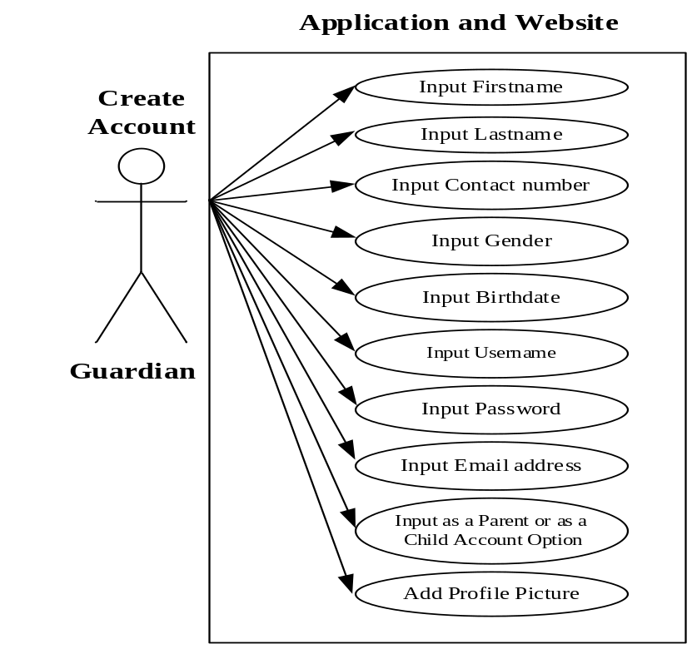
USE CASE DIAGRAMS
Create Guardian Account
Use Case Diagram
CHAPTER III

Slide 26
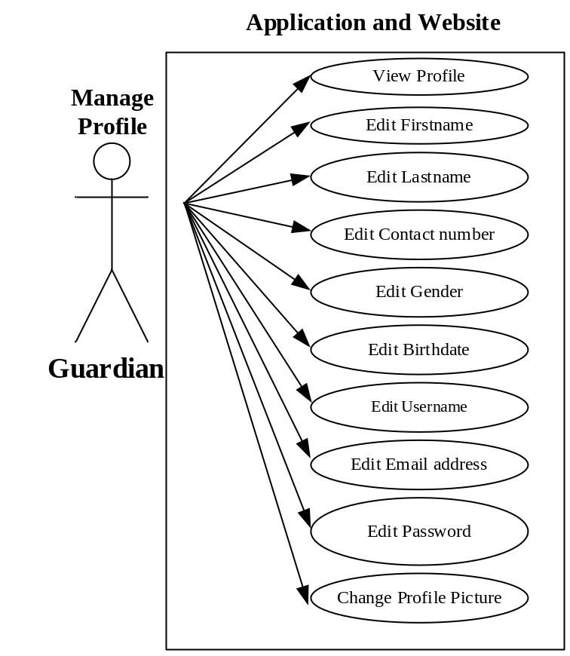
USE CASE DIAGRAMS
Manage Guardian Profile
Use Case Diagram
CHAPTER III

Slide 27
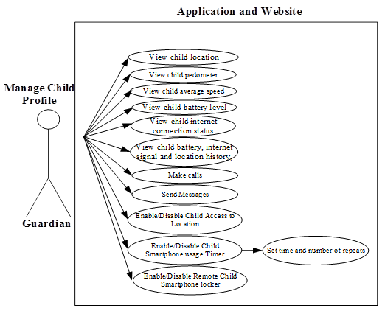
USE CASE DIAGRAMS
Manage Child Profile
Use Case Diagram
CHAPTER III

Slide 28
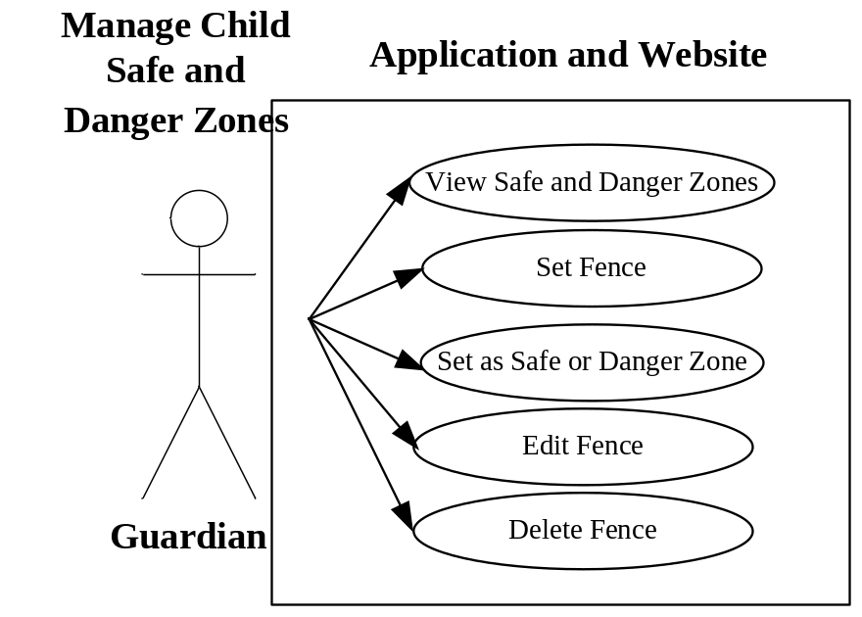
USE CASE DIAGRAMS
Manage Child Safe and
Danger Zones Use Case Diagram
CHAPTER III

Slide 29
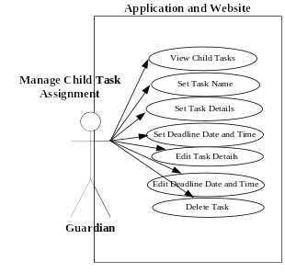
USE CASE DIAGRAMS
Manage Child Task Assignment
Use Case Diagram
CHAPTER III

Slide 30
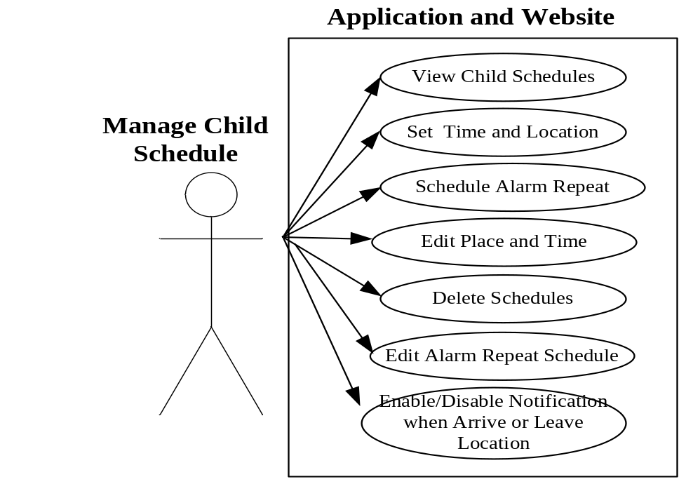
USE CASE DIAGRAMS
Manage Child Schedules Use Case Diagram
CHAPTER III

Slide 31
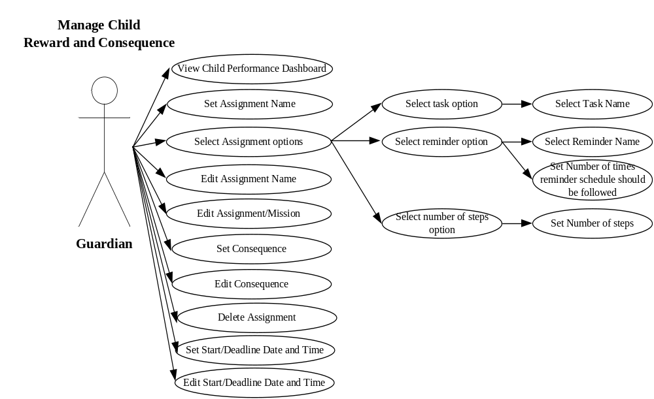
USE CASE DIAGRAMS
Manage Child Reward and Consequence
Assignment Use Case Diagram
CHAPTER III

Slide 32
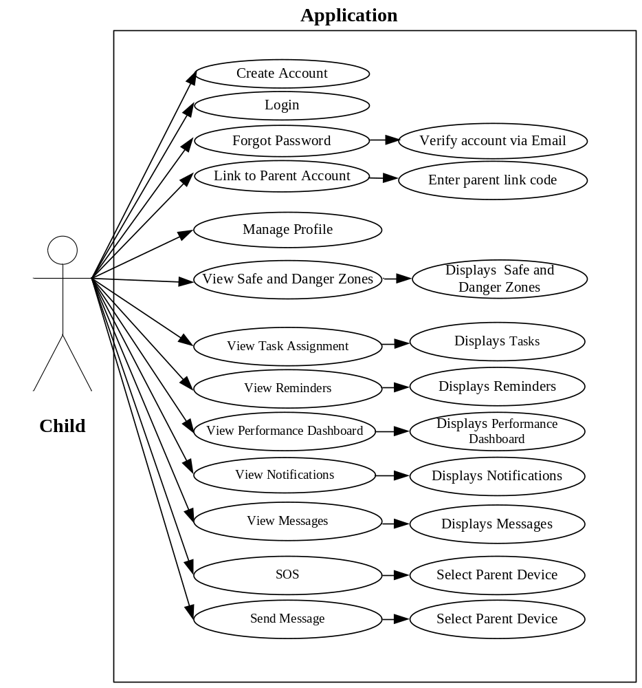
USE CASE DIAGRAMS
Child Use Case Diagram
CHAPTER III

Slide 33
STORYBOARD
CHAPTER III

Slide 34
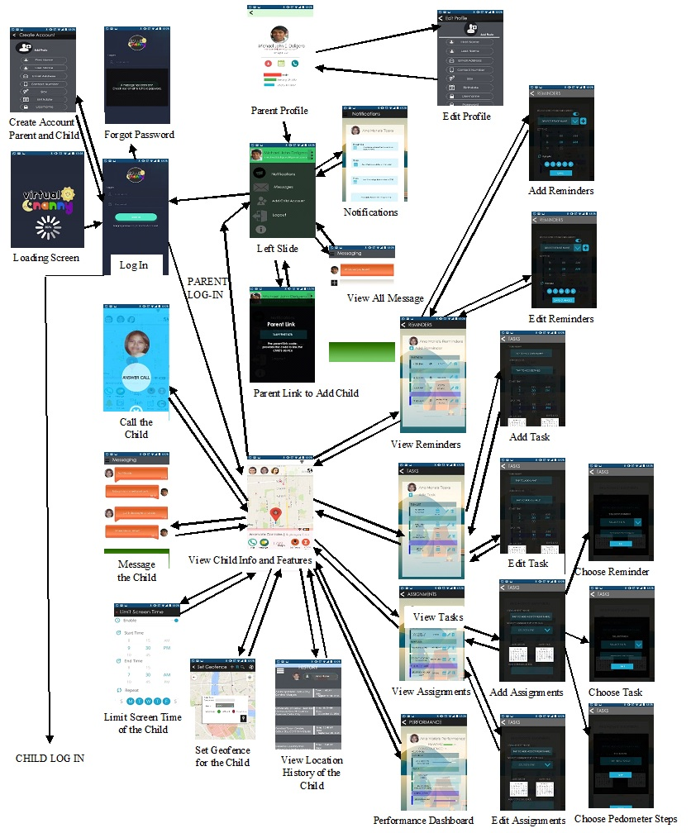
Guardian User Interface Storyboard
CHAPTER III

Slide 35
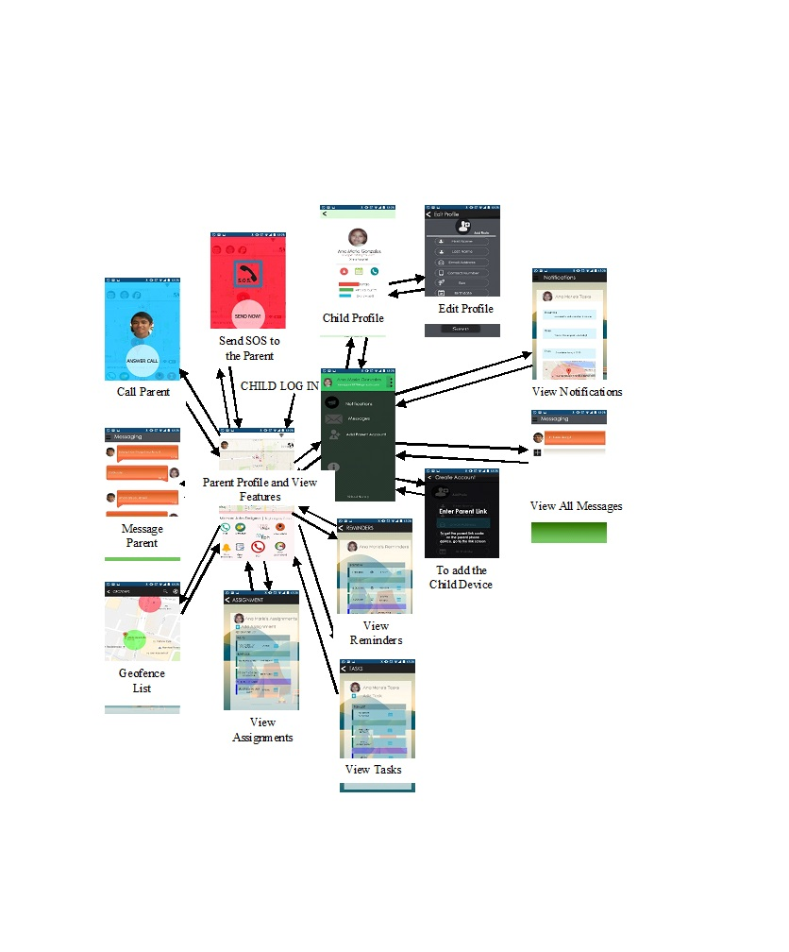
Child User Interface Storyboard
CHAPTER III

Slide 36
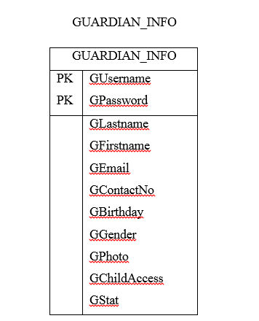
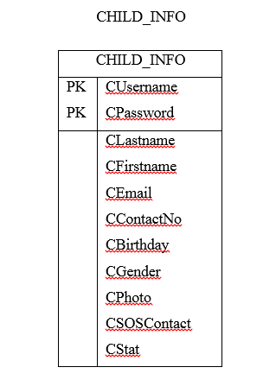
DATABASE DESIGN
CHAPTER III

Slide 37
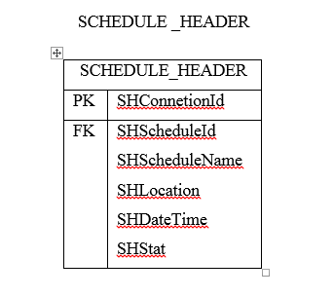
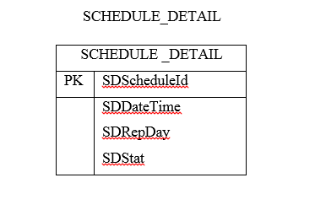
DATABASE DESIGN
CHAPTER III

Slide 38
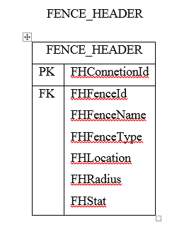
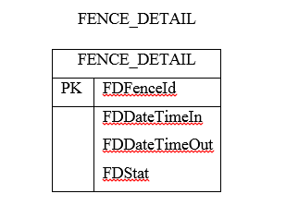
DATABASE DESIGN
CHAPTER III

Slide 39
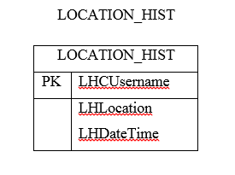
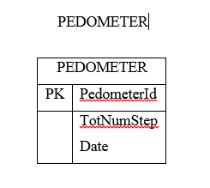
DATABASE DESIGN
CHAPTER III

Slide 40
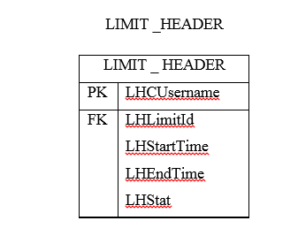
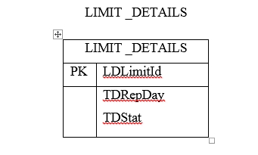
DATABASE DESIGN
CHAPTER III

Slide 41
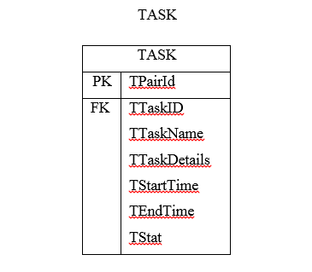
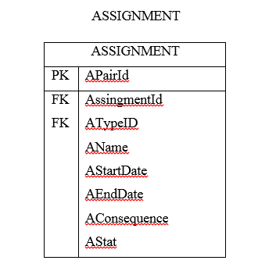
DATABASE DESIGN
CHAPTER III

Slide 42
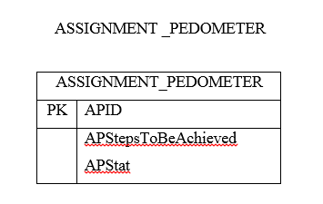
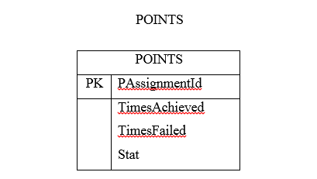
DATABASE DESIGN
CHAPTER III

Slide 43
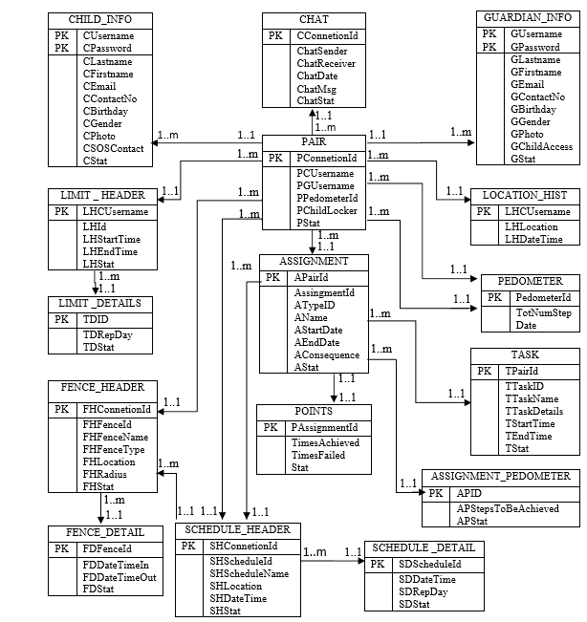
ENTITY RELATIONSHIP DIAGRAM
CHAPTER III

Slide 44
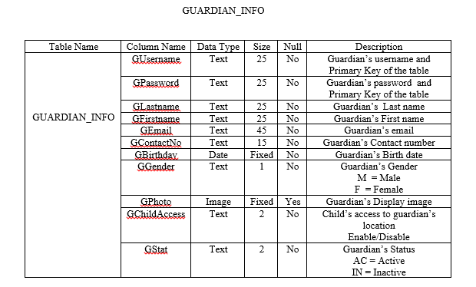
DATA DICTIONARY
CHAPTER III

Slide 45
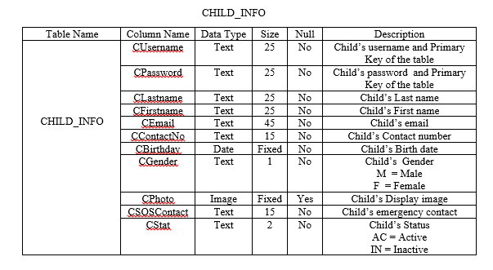
DATA DICTIONARY
CHAPTER III

Slide 46
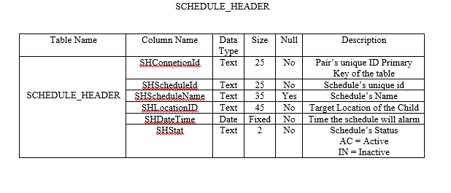
DATA DICTIONARY
CHAPTER III

Slide 47
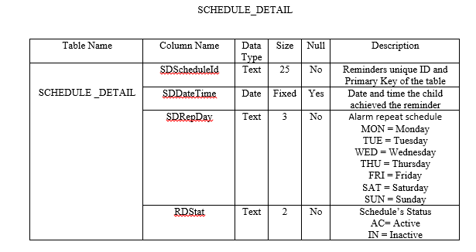
DATA DICTIONARY
CHAPTER III

Slide 48
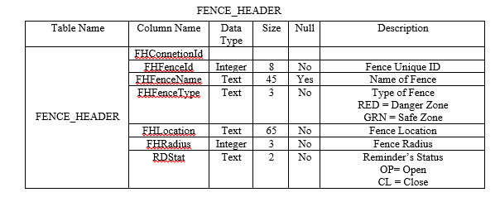
DATA DICTIONARY
CHAPTER III

Slide 49
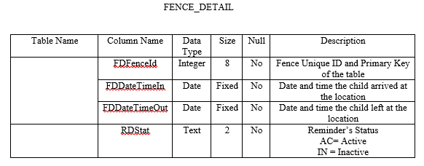
DATA DICTIONARY
CHAPTER III

Slide 50
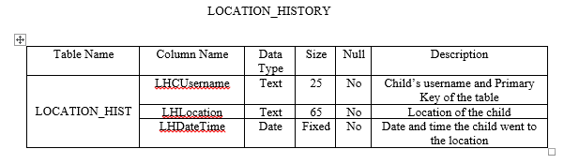
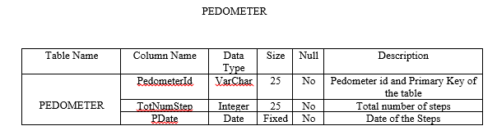
DATA DICTIONARY
CHAPTER III

Slide 51
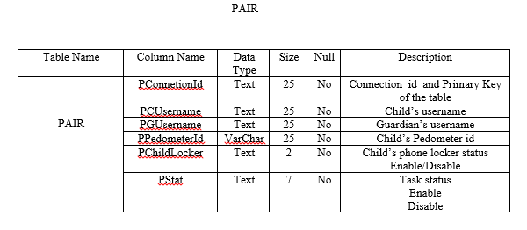
DATA DICTIONARY
CHAPTER III

Slide 52
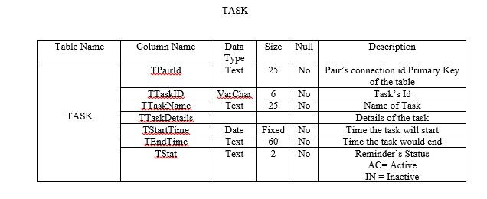
DATA DICTIONARY
CHAPTER III

Slide 53
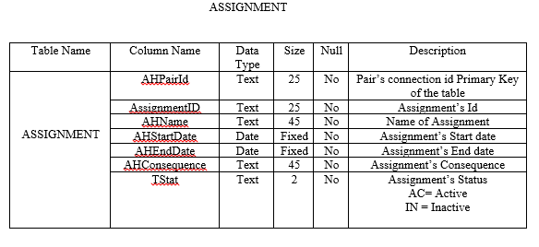
DATA DICTIONARY
CHAPTER III

Slide 54
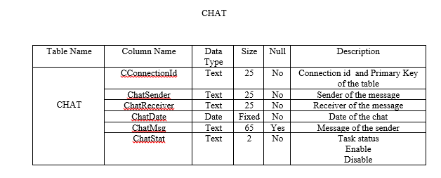
DATA DICTIONARY
CHAPTER III

Slide 55
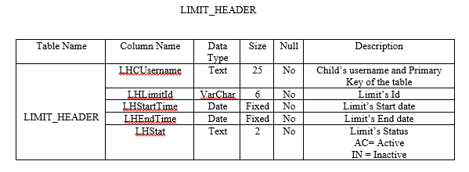
DATA DICTIONARY
CHAPTER III

Slide 56
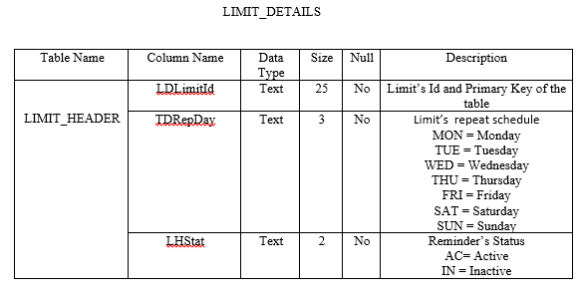
DATA DICTIONARY
CHAPTER III

Slide 57

DATA DICTIONARY
CHAPTER III

Slide 58

DATA DICTIONARY
CHAPTER III

Slide 59

NETWORK TOPOLOGY
CHAPTER III

Slide 60
DEVELOPMENT/CONSTRUCTION/BUILD PHASE
CHAPTER III
VIRTUAL NANNY: A CHILD MONITORING APPLICATION FOR GUARDIANS
CHAPTER III

Slide 61
SOFTWARE SPECIFICATION
For Development:
  SUN’s Java Development Kit (JDK)
  Android Software Developer’s Kit (SDK) and Android Studio/Eclipse IDE which support android application development
  Android Developer Tool (ADT), Eclipse/Aandroid Studio plug-ins
  Java Programming support for Eclipse IDE/Android Studio
  Google Maps API and Interface
  MySQL Database along with Hypertext Preprocessor (PHP)
For Deployment:
  Android Operating System
  Android API Level 16 (JellyBean) up to the latest version.
CHAPTER III

Slide 62
HARDWARE SPECIFICATION
For development:
•Computer Processor: i3 and above
•Operating System: Microsoft® Windows® 7/Vista /8/10 (x86 or x64)
•RAM: 4GB and above
•Hard Disk: At least 400MB space
•Hard Disk: At least 1GB for Android SDK, emulator system images, and caches
•Android Device running on Android OS Version 4.1 (Jellybean) up to the latest version.
For deployment:
•Android Device running on Android OS Version 4.1
GPS and SMS enabled smartphone with Google Maps integration
•RAM: At least 256MB free space
•Internal storage free space: at least 150MB
CHAPTER III

Slide 63

PROGRAM
SPECIFICATION
CHAPTER III

Slide 64

PROGRAM
SPECIFICATION
CHAPTER III

Slide 65

PROGRAM
SPECIFICATION
CHAPTER III

